Slide 1
Unit 3
SQL Queries -Embedded SQL -My SQL: Basics, Queries in MySQL
Algorithms for Query Processing and Optimization
Introduction to Transaction Processing Concepts and Theory
Concurrency control techniques.

Slide 2
Query Processing and Optimization

Slide 3
OUTCOME
What is a Query?
Steps involved in processing Query
How to translate a query into relational algebra expression
Generating different Query Trees
Query Optimization

Slide 4
What is a Query?
A query is a request for data or information from a database table or combination of tables.
For example
Select * from emp;
* represents all columns / attributes of a table
emp is a table / database

Slide 5
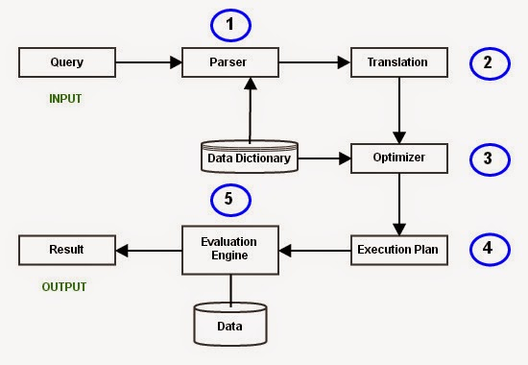
Typical Steps when processing a high level Query

Slide 6
Translating High level Query into Relational Algebra Expression

Slide 7
Example
Select ename from emp
where dno = (select dnumber from dept);

Slide 8
First step
Translating SQL query – Relational Algebra

Slide 9
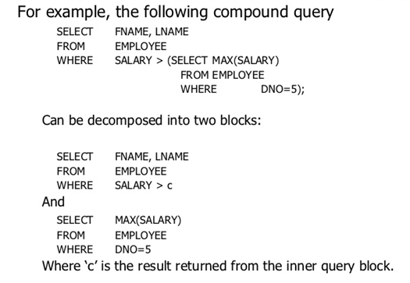

Slide 10
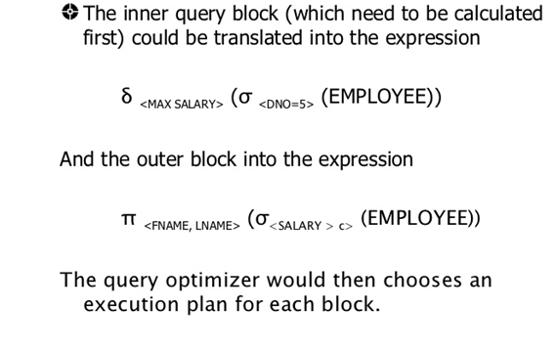
Equivalent Relational Algebra Expression

Slide 11
Generating Query Tree

Slide 12
Query Tree/Graph
Query tree - Tree data structure representing a relational algebra expression.
Query graph - Graph data structure representing a relational algebra expression.

Slide 13
Example
Select pnumber, dnum, Lname, Address, Bdata from Project, Department, Employee
where DNUM = DNUMBER AND MGRSSN = SSN AND PLOCATION = ‘STAFFORD’;
Tables used
Project
Department
Employee

Slide 14
Tables’ Schema
Employee
Department
Project
fname | lname | SSN | Dob | Address | Gender | Sal | SuperSSN | Dno
Dname | Dnumber | MgrSSN | Mgrstartdate
Pname | Pnumber | PLocation | Dnum

Slide 15
Cartesian Product (X)
Denoted by X
Combine all the columns of the tables
Here, Department X Project =
Dname | Dnumber | MgrSSN | MGRstartdate | Pname | Pnumber | PLocation | Dnum
cse | 1 | 100 | 1/2/20 | A | 200 | chennai | 1
cse | 1 | 100 | 1/2/20 | B | 300 | Mumbai | 2
IT | 2 | 200 | 4/5/19 | A | 200 | chennai | 1
IT | 2 | 200 | 4/5/19 | B | 300 | Mumbai | 2

Slide 16
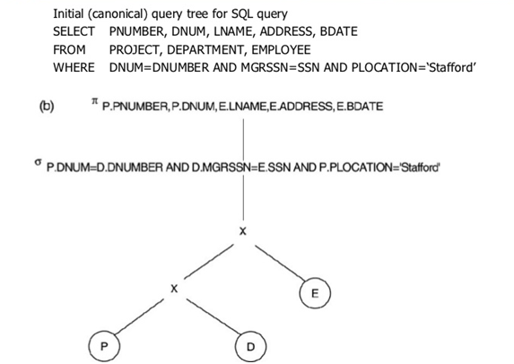

Slide 17
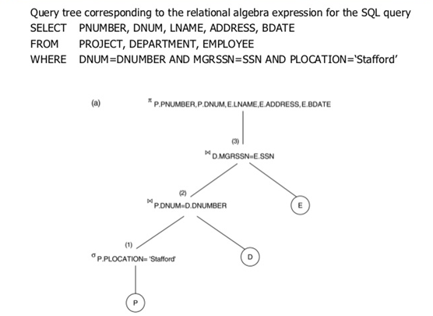

Slide 18
Join Operation
Denoted by ⋈
Equivalent to Cartesian product followed by Select Operation.
For example,
Dname | Dnumber | MgrSSN | MGRstartdate | Pname | Pnumber | PLocation | Dnum
cse | 1 | 100 | 1/2/20 | A | 200 | chennai | 1
IT | 2 | 200 | 4/5/19 | B | 300 | Mumbai | 2

Slide 19
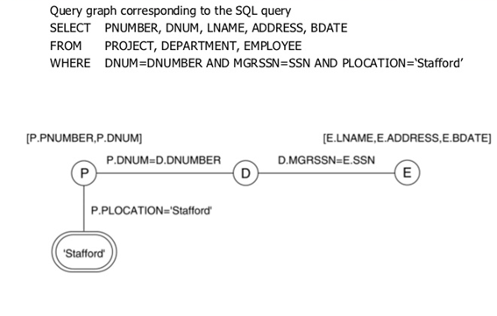

Slide 20
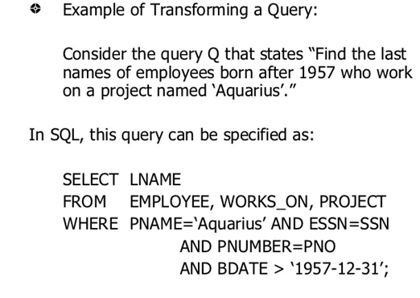

Slide 21
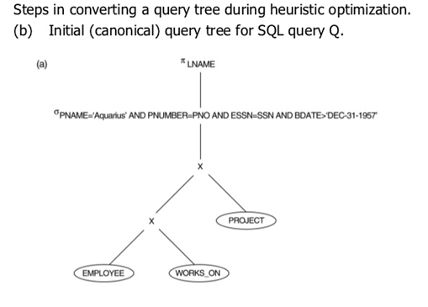

Slide 22
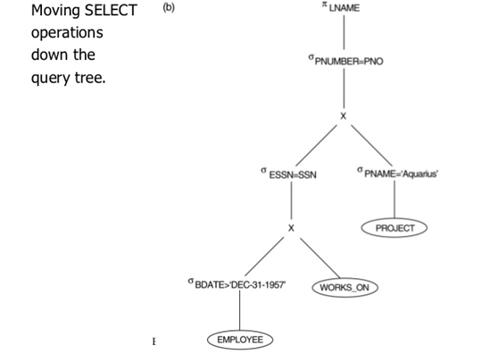

Slide 23
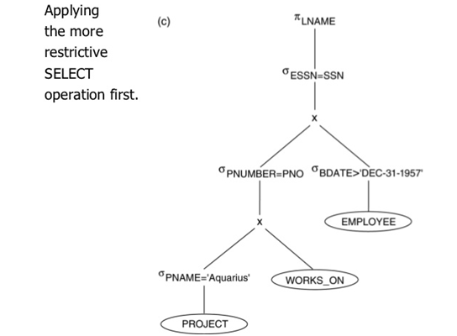

Slide 24
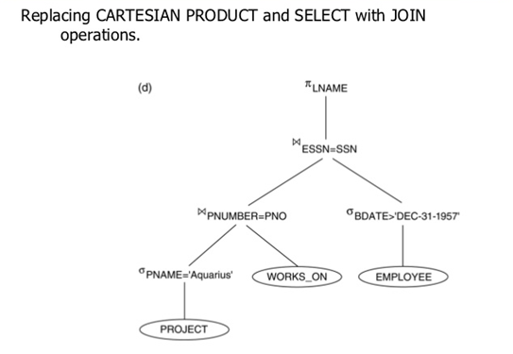

Slide 25
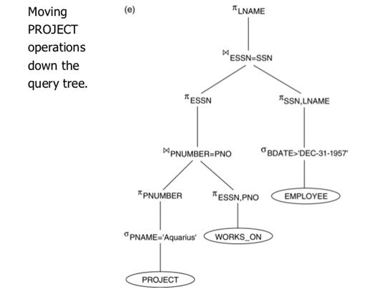

Slide 26
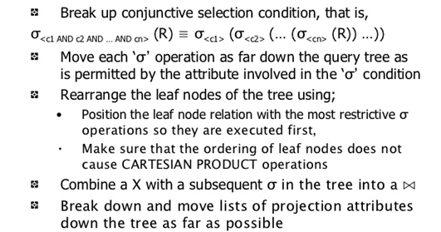

Slide 27
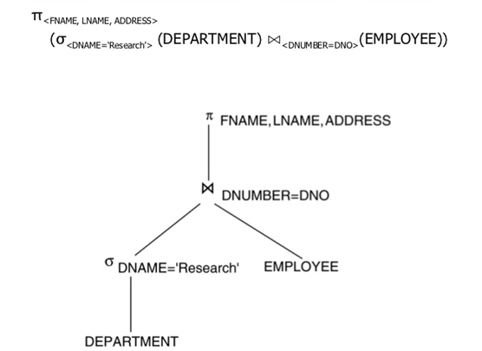

Slide 28
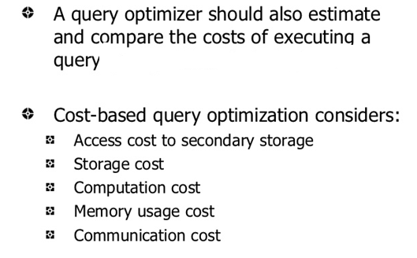
Based on different Cost Metrics

Slide 29
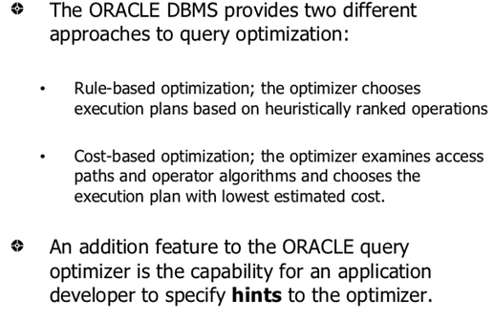

Slide 30
What is Transaction?
Logical unit of work that must be entirely completed or aborted
Consists of:
SELECT statement
Series of related UPDATE statements
Series of INSERT statements
Combination of SELECT, UPDATE, and INSERT statements

Slide 31
Transaction Properties
Atomicity
Consistency
Isolation - Data used during transaction cannot be used by second transaction until the first is completed
Durability - Ensures that once transactions are committed, they cannot be undone or lost

Slide 32
Need for Concurrency Control
In a multiprogramming environment where multiple transactions can be executed simultaneously, it is highly important to control the concurrency of transactions.
To ensure atomicity, isolation, and serializability of concurrent transactions.
Concurrency control protocols can be broadly divided into two categories −
Lock based protocols
Time stamp based protocols

Slide 33
Lock-based Protocols
Database systems equipped with lock-based protocols use a mechanism by which any transaction cannot read or write data until it acquires an appropriate lock on it. Locks are of two kinds −
Binary Locks − A lock on a data item can be in two states; it is either locked or unlocked.
Shared/exclusive − This type of locking mechanism differentiates the locks based on their uses. If a lock is acquired on a data item to perform a write operation, it is an exclusive lock. Allowing more than one transaction to write on the same data item would lead the database into an inconsistent state. Read locks are shared because no data value is being changed.

Slide 34
Lock Types
Binary lock
Shared Lock
Exclusive Lock

Slide 35
Problems of using Lock
Deadlock
Starvation

Slide 36
Four types of lock protocols
Simplistic / Basic Lock Protocol
Simplistic lock-based protocols allow transactions to obtain a lock on every object before a 'write' operation is performed. Transactions may unlock the data item after completing the ‘write’ operation.

Slide 37
Conservative Locking Protocol
Before initiating an execution, the transaction requests the system for all the locks it needs beforehand.
If all the locks are granted, the transaction executes and releases all the locks when all its operations are over.
If all the locks are not granted, the transaction rolls back and waits until all the locks are granted.

Slide 38
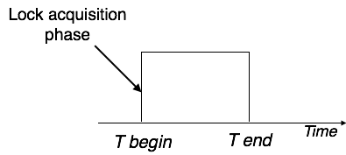

Slide 39
Two-Phase Locking 2PL
This locking protocol divides the execution phase of a transaction into three parts.
In the first part, when the transaction starts executing, it seeks permission for the locks it requires.
The second part is where the transaction acquires all the locks.
As soon as the transaction releases its first lock, the third phase starts.
In this phase, the transaction cannot demand any new locks; it only releases the acquired locks.

Slide 40
Two-Phase Locking (2PL)
Governing rules
Two transactions cannot have conflicting locks
No unlock operation can precede a lock operation in the same transaction
No data are affected until all locks are obtained

Slide 41
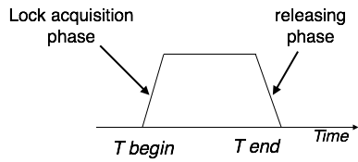

Slide 42
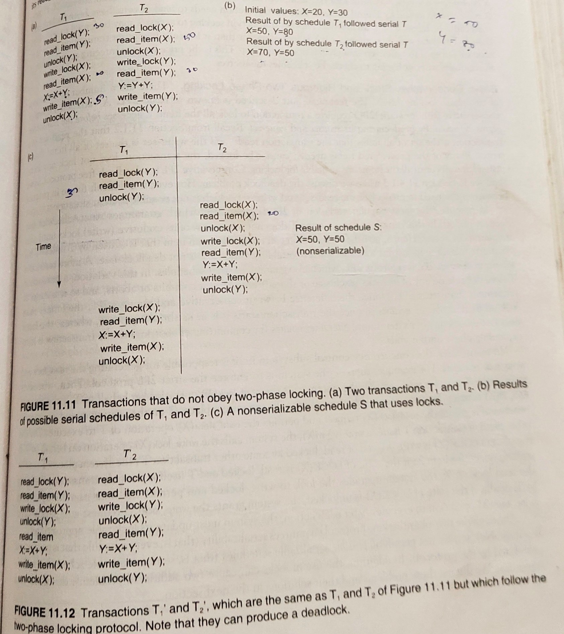
Guaranteeing Serializability

Slide 43
Phases
Growing Phase
Shrinking Phase
Conversion of Locks

Slide 44
Two-phase locking has two phases, one is growing, where all the locks are being acquired by the transaction; and the second phase is shrinking, where the locks held by the transaction are being released.
To claim an exclusive (write) lock, a transaction must first acquire a shared (read) lock and then upgrade it to an exclusive lock.

Slide 45
Strict Two-Phase Locking
The first phase of Strict-2PL is same as 2PL. After acquiring all the locks in the first phase, the transaction continues to execute normally.
But in contrast to 2PL, Strict-2PL does not release a lock after using it.
Strict-2PL holds all the locks until the commit point and releases all the locks at a time.

Slide 46
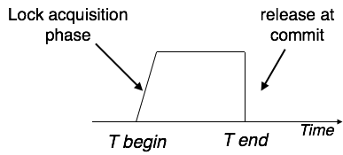

Slide 47
Variations
Basic
Conservative - requires a transaction to lock all items it access before the transaction begins execution
Strict – transaction does not release write until it is done
Rigorous - transaction does not release write as well as read until it is done

Slide 48
Timestamp-based Protocols
The most commonly used concurrency protocol is the timestamp based protocol.
This protocol uses either system time or logical counter as a timestamp.
Every transaction has a timestamp associated with it, and the ordering is determined by the age of the transaction.

Slide 49
Denotions
The timestamp of transaction T_{i} is denoted as TS(T_{i}).
Read time-stamp of data-item X is denoted by R-timestamp(X).
Write time-stamp of data-item X is denoted by W-timestamp(X).

Slide 50
Working Methodology
If a transaction Ti issues a read(X) operation −
If TS(Ti) < W-timestamp(X)
Operation rejected.
If TS(Ti) >= W-timestamp(X)
Operation executed.
All data-item timestamps updated.

Slide 51
Working Methodology
If a transaction Ti issues a write(X) operation −
If TS(Ti) < R-timestamp(X)
Operation rejected.
If TS(Ti) < W-timestamp(X)
Operation rejected and Ti rolled back.
Otherwise, operation executed.

Slide 52
Sql Queries

Slide 53
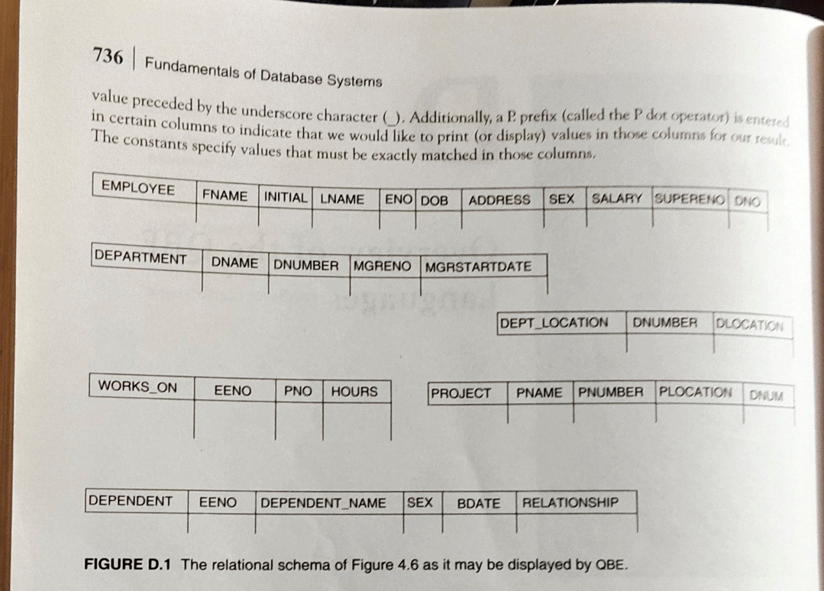
SCHEMA FOR REFERENCE

Slide 54
Retrieve the date of birth and address of an employee ‘humritha naveena’;

Slide 55
Retrieve the name and address of all employees who work for ‘Research Dept’.

Slide 56
For every project located in chennai, list the project number, the controlling department number and the department manager’s last name and address.

Slide 57
For each employee, retrieve the employee’s first and last name and the first and last name of his or her immediate supervisor.

Slide 58
Retrieve the salary of every employee and all distinct salary values

Slide 59
Retrieve all employees whose address is in hyderabad.

Slide 60
Find all employees who were born after 1950s

Slide 61
Retrieve all employees in department 5 whose sal is between 30,000 and 40,000

Slide 62
Retreive a list of employees and the projects they are working on, ordered by department and within each department, ordered alphabetically by last name, first name.

